Slide 1
Hadoop Streaming

Slide 2
Outline
Hadoop Streaming
Word Count
Brief Introduction to HDFS
Exercises

Slide 3
HDFS Concepts
HDFS is a filesystem designed for storing very large files with streaming data access patterns, running on clusters of commodity hardware.

Slide 4
HDFS Concepts
“Very large” in this context means files that are hundreds of megabytes, gigabytes, or terabytes in size. There are Hadoop clusters running today that store petabytes of data.
Streaming data access : HDFS is built around the idea that the most efficient data processing pattern is a write-once, read-many-times pattern.
Commodity hardware : Hadoop doesn’t require expensive, highly reliable hardware to run on.

Slide 5

Basic Filesystem Operations
To create a home directory for your current user: hadoop fs -mkdir -p /user/hduser
To create a directory: hadoop fs -mkdir tempinput hadoop fs -mkdir tempoutput
To display an HDFS file listing:
hadoop fs -ls

Slide 6
Basic Filesystem Operations
Assume you have a test file input/test1.txt in your local file system
To copy a file from the local filesystem to HDFS: hadoop fs -copyFromLocal input/test1.txt tempinput/test1.txt
To copy the file back to the local filesystem and check whether it’s the same: hadoop fs -copyToLocal tempinput/test1.txt test1.copy.txt
To delete a directory: hadoop fs -rm -r -f tempoutput

Slide 7
Hadoop Streaming
Hadoop provides an API to MapReduce that allows you to write your map and reduce functions in languages other than Java.
In this course we mainly use python

Slide 8
Hadoop Streaming
InputSplit
ReduceTask
Output
MapTask
stdin
stdout
stdin
stdout
uMap
uReduce

Slide 9
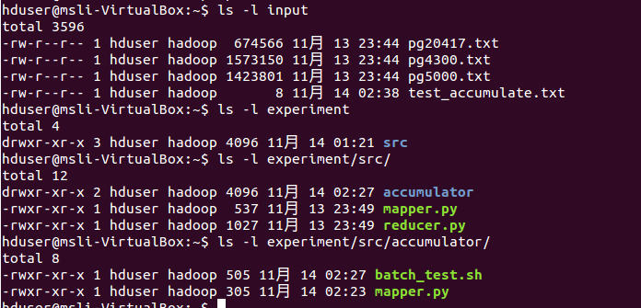
Hadoop Streaming Examples
First, copy the given examples (experiment and input dirs) to your home dir.
Make sure you have following results

Slide 10
Hadoop Streaming Examples
WordCount AGAIN!
The “trick” behind the following Python code is that we will use HadoopStreaming for helping us passing data between our Map and Reduce code via STDIN (standard input) and STDOUT (standard output). We will simply use Python’s sys.stdin to read input data and print our own output to sys.stdout. That’s all we need to do because HadoopStreaming will take care of everything else!

Slide 11
Word Count Example
Mapper experiment/src/mapper.py
Reducer experiment/src/reducer.py Make sure these *.py files have execution permission with the following command(remember this all though this experiment) chmod + x experiment/src/mapper.py

Slide 12
Mapper.py
#!/usr/bin/env python
import sys
# input comes from STDIN (standard input)
for line in sys.stdin:
# remove leading and trailing whitespace
line = line.strip()
# split the line into words
words = line.split()
# increase counters
for word in words:
# write the results to STDOUT (standard output);
# what we output here will be the input for the
# Reduce step, i.e. the input for reducer.py
#
# tab-delimited; the trivial word count is 1
print '%s\t%s' % (word, 1)

Slide 13
Reducer.py
#!/usr/bin/env python
from operator import itemgetter
import sys
current_word = None
current_count = 0
word = None
# input comes from STDIN
for line in sys.stdin:
# remove leading and trailing whitespace
line = line.strip()
# parse the input we got from mapper.py
word, count = line.split('\t', 1)
# convert count (currently a string) to int

Slide 14
Reducer.py
try:
count = int(count)
except ValueError:
# count was not a number, so silently
# ignore/discard this line
continue
# this IF-switch only works because Hadoop sorts map output
# by key (here: word) before it is passed to the reducer
if current_word == word:
current_count += count
else:
if current_word:
# write result to STDOUT
print '%s\t%s' % (current_word, current_count)
current_count = count
current_word = word
# do not forget to output the last word if needed!
if current_word == word:
print '%s\t%s' % (current_word, current_count)

Slide 15

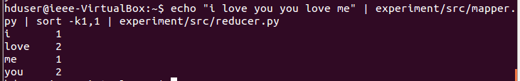
Word Count Example
Test your code locally first and make sure they are correct
(cat data | map | sort | reduce)
Test Mapper: echo "i love you" | ~/experiment/src/mapper.py
Test Reducer after sorting: echo "i love you you love me" | ~/experiment/src/mapper.py | sort -k1,1| ~/experiment/src/reducer.py

Slide 16
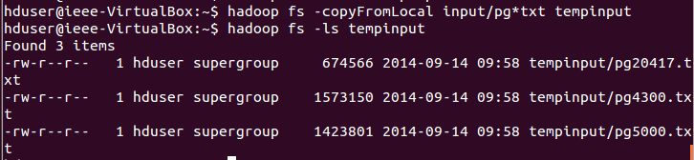
Word Count Example
Copy local example data to HDFS: hadoop fs -copyFromLocal ~/input/pg*txt tempinput

Slide 17
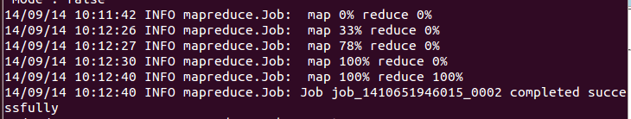
Word Count Example
Wordcount with hadoop streaming cd ~/experiment/src; hadoop jar /usr/local/hadoop/share/hadoop/tools/lib/hadoop-streaming-2.2.0.jar -files mapper.py,reducer.py -mapper mapper.py -reducer reducer.py -input tempinput -output tempoutput;
Then map&reduce process will start

Slide 18
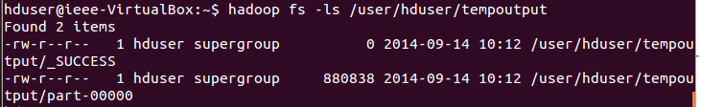
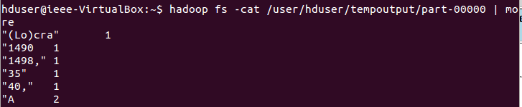
Word Count Example
Show the results hadoop fs -cat tempoutput0/part-00000 | less

Slide 19

Word Count Example
You can change the MR job name with the following option: -jobconf mapred.job.name="wordcount job" hadoop jar /usr/local/hadoop/share/hadoop/tools/lib/hadoop-streaming-2.2.0.jar -files mapper.py,reducer.py -mapper mapper.py -reducer reducer.py -input tempinput -output tempoutput -jobconf mapred.job.name="wordcount job"

Slide 20
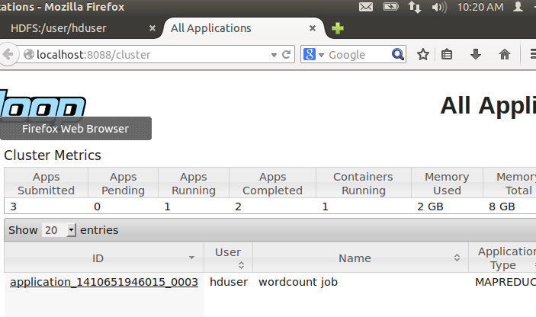
Word Count Example
Visit localhost:8088/cluster:

Slide 21

Word Count Example
Mapper Only(without reducer) option: -reducer NONE
(“NONE” all in caps)

Slide 22
Chaining Example
Chaining jobs
Not every problem can be solved with a MapReduce program, but fewer still are those which can be solved with a single MapReduce job. Many problems can be solved with MapReduce, by writing several MapReduce steps which run in series to accomplish a goal:
Map1 -> Reduce1 -> Map2 -> Reduce2 -> Map3...
If you build up everything , such as the sorter , partitioner etc. , all by yourself, it’s quite easy to chain jobs together.
But in hadoop streaming , you need other tools’ help. In this experiment, I use bash .

Slide 23
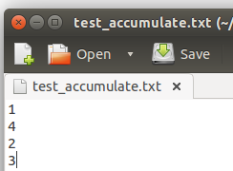
Chaining Example
Chaining jobs example: Accumulator (here I use Mapper Only mode)
(x + x + x + x = ?) x>>Map1>>Map2>>Map3>>answer
First, remove old files in hdfs: hadoop fs -rm -r -f temp*;
Copy New test file into hdfs: hadoop fs -mkdir tempinput; hadoop fs -copyFromLocal ~/input/test_accumulate.txt tempinput/test_accumulate.txt

Slide 24
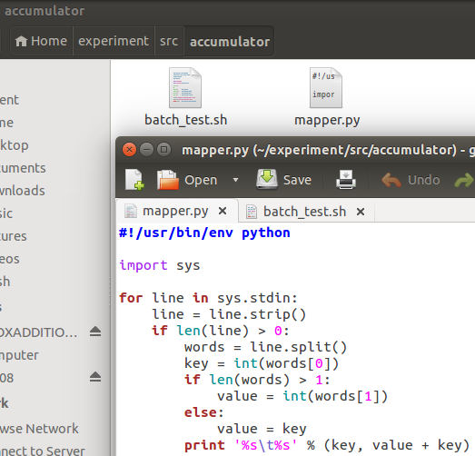
Chaining Example
The example mapper: ~/experiment/src/accumulator/mapper.py

Slide 25
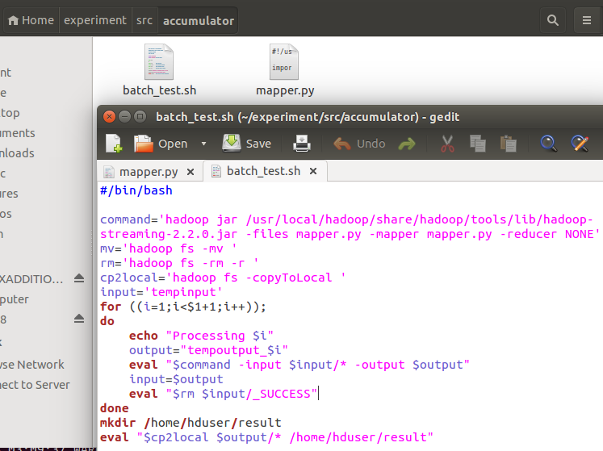
Chaining Example
The example chaining script: ~/experiment/src/accumulator/batch_test.py

Slide 26
Chaining Example
Run jobs: cd ~/experiment/src/accumulator ./batch_test.sh 3

Slide 27
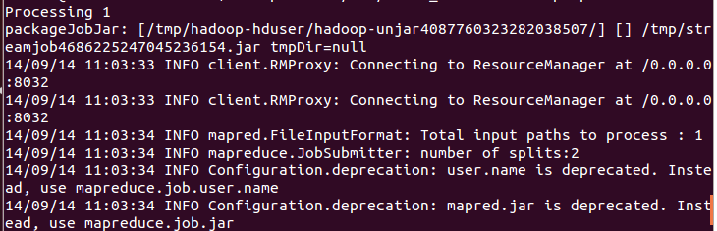
Chaining Example
Chaining jobs
3 rounds of iterations

Slide 28
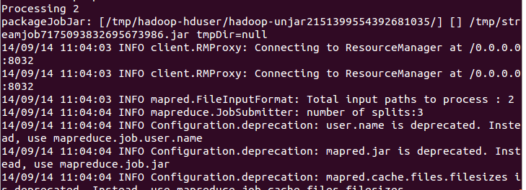
Chaining Example
Chaining jobs
3 rounds of iterations

Slide 29
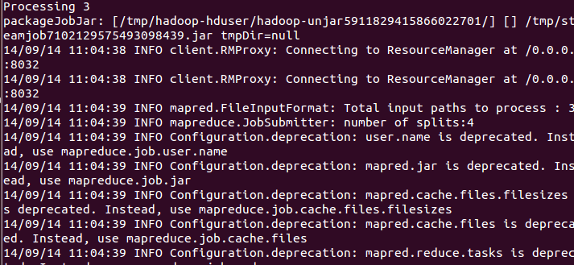
Chaining Example
Chaining jobs
3 rounds of iterations

Slide 30
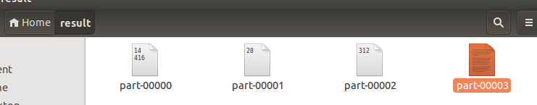
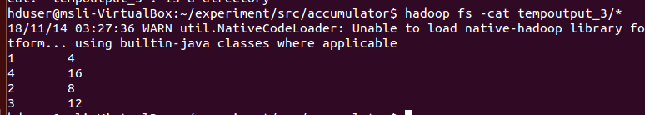
Chaining Example
Chaining jobs
The result will be stored in ~/result
You can also show the result via following code: hadoop fs -cat tempoutput_3/*

Slide 31
Hadoop Streaming
If you are interested in this part , you may learn more with a further study on oozie or programming with Java on hadoop.

Slide 32
exercise1
There is an English essay , try to write a mapper.py and a reducer.py to calculate the average length of each word starting from “A” to “Z”.
Eg. we become what we do
w 2.66 =[len(“we”)+len(“what”)+len(“we”)]/3
b 6
d 2

Slide 33
exercise2
There is a basic algorithm about PageRank in the following website:
https://en.wikipedia.org/wiki/PageRank#Algorithm
https://segmentfault.com/a/1190000000711128
It’ll take several rounds of iterations to work out the final pagerank value. Try to write you own mapper.py and reducer.py to implement this algorithm.

Slide 34
exercise2
To make it easier to understand, I’ll give the following example: α = 0.85
Input: Output:
ID PR Link ID ID PR Link ID
1 0.25 2 3 4 1 0.0375 2 3 4
2 0.25 3 4 2 0.3208 3 4
3 0.25 4 3 0.2146 4
4 0.25 2 4 0.4271 2
Map&Reduce

Slide 35
exercise2
We’ll get the final pagerank value in this way:
Input: temp_1 temp_2
………temp_k Output
In this process , the output of the previous reducer becomes the input of the next mapper.
Map1&Reduce1
Map2&Reduce2
Mapk&Reducek

Slide 36
Deadline
2018/11/22

Slide 37
Thank You
Questions and Answers !!!

